Slide 1
Results of the 2017/19 State of California Healthy Kids Survey:
The 17th Biennial Student Survey
Greg Austin & Leslie Poynor
WestEd, November 6, 2020
Full Report Posted:
https://calschls.org/reports-data/#state-level_reports
Notes:
This presentation summarizes some of the key findings of the 2017/19 Biennial State of California Healthy Kids Survey, the 17th of the series, part of the California School Climate, Health, and Learning Survey System (CalSCHLS). We focus on how current results on key indicators compared to the previous survey in 2015/17 but also look at trends since 2011/13. The full report with all the findings in detail is posted on the CalSCHLS website.

Slide 2
Today’s Topics
Survey content and method
School climate and pupil engagement
Mental health
Alcohol, tobacco, drug use, and vaping
Student developmental supports
Data dashboards and resources
Q&A
Notes:
As we will show, the results across these topics were mixed:
Improvements in school attendance BUT little progress in improving school climate
Big, long-term reductions in alcohol and tobacco use
BUT worrisome current results for marijuana use and vaping
As well as for mental health indicators

Slide 3
California Healthy Kids Survey
Largest, oldest (since 1998) statewide effort in nation to provide data to improve school climate, academic achievement, and student well-being.
Currently administered by 70% of CA districts to 1.2M students — 26% annually.
A project of CA Dept of Education, implemented by WestEd.
Part of CDE’s California School Climate, Health, and Learning Survey System, along with school staff and parent surveys.
State, county, & district reports and online access to key findings (Data Dashboard) at calschls.org.

Slide 4
Biennial State CHKS Method
Randomly-selected representative state sample in grades 7, 9, & 11, completed by 45,848 respondents in 50 middle, 52 high, and 10 continuation schools.
Since 2011/12, online data collection embedded within local CHKS administration over two years (to cover all districts).
    Replaces similar but separate, single-year California Student Survey (1985-2009)
Content: CHKS Core + AOD module = CSS.
Financial incentives to districts.
    CHKS fees up to 900 students per grade & $200 MS/$300 HS if they administer both modules.
Funded by Dept Health Care Services in partnership with CDE.
Notes:
The survey was administered to a randomly-selected, representative state sample in grades 7, 9 and 11. It was completed online by 45,848 respondents in 50 middle, 52 high, and 10 continuation schools. This differs from the sample used in local district administrations in which results for continuation schools are included in the Nontraditional School Sample. This might affect comparability of results.
The Biennial Survey began in 1985 as the California Student Survey of Substance Use and Risk Behaviors (CSS). The CSS formed the core of the CHKS and in 2011/12, the sponsoring agencies decided to replace the separate CSS with a state sample embedded within local CHKS data collection. In the Biennial Report and this presentation, we only look at six-year trends since 2011/13 because that is when this new method was initiated.
The main difference from the CSS method is that it now takes two years to collect all the data in the participating schools because districts administer the survey at different times over a two-year period.
The Biennial instrument consists of the CHKS Core and supplemental AOD module, which together replicate the full CSS. There is some difference between the samples that completed these two modules but data for both validly represent the state, with the student response rates at 75% for the Core and 71% for the AOD Module. More information about the method is provided by the full report.

Slide 5
School climate and pupil engagement

Slide 6
Overview to Trends Since 2015/17
Major improvements in school attendance and truancy BUT overall lack of progress in key factors of school success and LCAP state priorities.
  Academic motivation and self-reported grades
  School connectedness and safety*
  Fighting at school and victimization (bullied/harassed)
  Student developmental supports (e.g., caring relationships) central to positive school climate
*LCAP School Climate Indicators
Notes:
Overall, shows lack of progress since 2015/17 in key factors of school success, including state-required priorities that must be improved by districts (since July 2014) through Local Control and Accountability Plans

Slide 7
School Attendance: All of past 30 days
Marked improvements of 6-8 points across grades
13% (MS) to 17% (HS) missed three or more days (chronic absentees)
Truancy also declining since 2013/15
Notes:
One of the survey’s most positive findings: Not missing any school improved markedly all grades (6-8 points) to 50% in 7th, 44% in 9th, and 39% in 11^{th.}
13%, 15%, and 17% missed school three or more days, an indicator of chronic absenteeism.
Truancy (skipping school or cutting classes past year) more than a few times has declined in high school since 2013/15, to 5% in 9th, 8% in 11th.

Slide 8
Academic Motivation Scale
Try hard at schoolwork to do good, better, understand, because interested.
Notes:
Although attendance improved, academic motivation, another indicator of pupil engagement did not, although high school results are slightly higher than in 2013/15. This is a good illustration of the problem with middle school trends, showing improvements in 2015/17 but current results returned to same level as 2013/15. The average percentage of students indicating agreement (agree or strongly agree) with the four-item Academic Motivation scale increased markedly in all grades (by about five points) in 2015/17 but no further increase has occurred. The 2017/19 rate even declined five points in 7th grade to 75%, returning to the level in 2013/15, the first year this question was on the survey. In high school, there was little change, at 72% in 9th grade and 71% in 11th. The high school percentages are still higher than in 2013/15, but overall, these results may be a warning sign that improvement in this key engagement indicator has stalled. (Table A4.6)

Slide 9
School Connectedness Scale
At school, happy, part of, safe, close to people, treated fairly
Notes:
Trends since 2015/17 for school connectedness are similar to those for academic motivation and show little improvement since 2011/13. School connectedness is one of the indicators of school climate that a California school district must address in its LCAP. This is a very important indicator. Research has linked school connectedness with multiple positive academic, social-emotional, and health outcomes. The CHKS measures it using a five-item scale (see slide). Here are six-year trends for the average who agreed or strongly agreed with each questions. The average percentage of students indicating agreement is 62% in 7th grade, declining to 57% in 9th, and 53% in 11th. As with Academic Motivation, compared to 2015/17, these results are lower in 7th grade and little changed in high school. Overall, School Connectedness is at the same level as it was in 2013/15 and little different than 2011/13, despite it becoming an LCAP priority in 2014. (Table A4.6)
Notice the positive spike in 7th grade in 2015/17 that then returned to previous levels. We saw this in a number of indicators. Probably results two years ago were an anomaly and that generally there has been little progress.

Slide 10
Feel Safe or Very Safe at School
Notes:
Overall, perceived safety (report feeling safe or very safe), another LCAP indicator, was lower in each grade than in 2015/17 and 2011/13 as well. Among the most disappointing results.
The percentage of students indicating they felt safe or very safe at school markedly declined to 61%, 55%, and 54%, by ascending grade. These rates are lower compared to those of 2011/13 in each grade, lower by two points in 7th grade, six points in 9th, and nine points in 11th. Among high school students, the decline has been consistent since 2013/15. Perceived safety is now the lowest level in six years. Almost half of respondents in high school didn’t feel safe at school. (Table A5.1)

Slide 11
Any Harassment/Bullying Past 12 Months
Notes:
Youth who experience harassment/bullying at school have consistently been shown to report a wide range of other problems, including lower engagement, connectedness, and mental health. Bullying has always been highest in middle school, making the rise of three points in 7th grade disconcerting but rates are still lower than in 2011/13 and 2013/15. In high school, there was little short-term improvement, but more encouraging, current rates are substantially lower than in 2013/15, when they peaked. This graph shows results for experiencing any harassment in the past 12 months, including for five bias-related reasons (gender, race/ethnicity, religion, sexual orientation, or disability).

Slide 12
Mental Health

Slide 13
Chronic Sadness/Hopelessness
Rise of 3-6 points across grades to highest levels in six years.
Notes:
This is a complex question: “During the past 12 months, did you ever feel so sad or hopeless almost every day for two weeks or more that you stopped doing some usual activities?” But we have found that it is a marker for a wide range of problems among youth.
Also, among most disappointing results (along with perceived school safety)
Chronic, debilitating sadness/hopelessness rose in all grades (3-6 points) to 30%, 33%, & 37%.
Highest levels reported in the past six years and reverse small improvements that occurred in 2015/17

Slide 14
Suicide Contemplation
Notes:
Little change in suicide ideation, in contrast to a notable decline in 2015/17.
Among high school students, contemplating suicide held steady at 16%/17% (even increasing one point in 11th).

Slide 15
Alcohol, Tobacco, and Other Drug (ATOD) Use
Notes:
Now let’s look at one of the main risk behaviors assessed by the CHKS that these developmental supports can help reduce: AOD use

Slide 16
Overview of Current Substance Use (Past 30 Days)
 | Grade 7 (%) | Grade 11 (%)
Any AOD Use | 7 | 23
Any alcohol | 4 | 16
Any drug use | 5 | 17
Marijuana | 4 | 16
Binge drinking | 1 | 9
Cigarette smoking | 1 | 2
Notes:
To begin, let’s look at how the level of use in the past 30 days varies across substance use categories and grades.
AOD use between 7th and 11th grades increases by a factor of 3-4 points.
Alcohol use still fuels the level of overall AOD use but use of marijuana is now equal, for the first time, and use of any drug is even slightly higher.
About half of seniors who drank alcohol engaged in binge drinking (5 or more drinks in a row in a single setting).
Cigarette smoking is reported by only 2% of 11th graders,.

Slide 17
Summary of High-risk Substance Use Indicators: 11th Grade
Estimated 10%-14% are high-risk (heavy, frequent) users
Binge drinking 9% — half current drinkers
Weekly marijuana (3+ days) 9% — half current users
Heavy current drug use (combined drugs 3+ days) 9%
Ever drunk/high 7+ days 13%
DUI involvement 13% (alcohol or drugs for first time)
One or more AOD problems 11% (-3 pts); negative experiences (14%)
All down slightly from 2015/17
Notes:
Here are seven indications of risky patterns of use. Currently it appears that from 10% to 14% of seniors are heavily involved in substance use and at high risk of problems and in need of assistance.
Half of current binge drinkers and marijuana users are using on 3 or more of the past 30 days, an indication of weekly use.

Slide 18
AOD Current Use Trends Mixed
Pronounced decline in all grades since 2011/13 in alcohol drinking and cigarette smoking
    Binge drinking is now only reported by 4% of 9th graders and 9% of 11th, less than half the level six years ago.
    Cigarette smoking is down to 2% in high school.
In HS, prescription drugs to get “high” down slightly (2 points) to 2%. Inhalants and other drugs stable.
Marijuana use levels off after four years of substantial decline; use at school increases slightly.
  Among most troubling findings
Notes:
Reduction in alcohol drinking and cigarette smoking a success story over the past six years.

Slide 19
Current Alcohol Use (Past 30 Days)
Notes:
Current use since 2011/13 has dropped by half in high school grades and almost two-thirds in 7th grade.

Slide 20
Binge Drinking (Past 30 Days): 5 or more drinks in a row, single setting
Notes:
There have been even bigger, consistent declines in binge drinking (consuming 5 or more drinks in a row in a single setting). This is another very positive trend. Compared to six years ago (2011/13), it is less than half in 11th grade and almost two-thirds lower in 9th. Down to negligible levels in 7th.

Slide 21
Marijuana Use Past 30 Days
Notes:
Current trends for marijuana are different. Between 2011/13 and 2015/17, it also looked that we were succeeding in reducing marijuana use, but these declines ended in 2019/20.
Leveled off in high school and even increased two points in 7th
Current use level at 4%, 10%, and 16%, the same level as current use of alcohol for the first time in the history of the survey.
Moreover, use at school in the past 30 days increased slightly in all grades (by about one point), ending the previous declining trend.

Slide 22
Putative Influences on Marijuana
Changes in item wording complicate interpretation of trend but several use influences are consistent with an uptick in use.
Declines in perceived harm of occasional use in 7th and 9th grades and in personal and parental disapproval in all grades.
Previous declines in perceived availability of marijuana leveled off.
  Almost half of 11th graders (46%) report marijuana easily available — easier to get than alcohol.
New data reveals widespread vaping (higher than for tobacco) and oral ingestion (edibles) among users.
  Both done by about one-fifth of 11th graders.
  Reputation as being safer/healthier than smoking, and less detectable (link to rise in use at school).
Notes:
Interpreting the meaning of this change in the data is complicated by a change in the item wording, from asking just about marijuana smoking to asking about consuming through vaping devices (e-cigarettes) or oral ingestion of edibles. It might be expected that making the question more specific about multiple methods of use would lead to higher prevalence rates. This suggests previous declines during the period when these alternatives have become more common, were underestimates and that current wording is giving us more accurate prevalence rates.
But results on several questions assessing factors that typically influence use trends — perceived harm, use disapproval, and perceived availability — are consistent with there occurring an uptick in use.
New data on two new alternative modes of administration — by vaping and eating or drinking edibles — suggests they may also be playing a role in this change.
E-cigarettes were introduced in the US in 2007 but modern vaping devices developed around the end of the first decade, leading us to ask about vaping in 2013, and their popularity growing with introduction of JUULs in 2015.
The availability of edibles also expanded following legalization of medical marijuana use in 1996 and especially after adult recreational use legalized beginning in 2012 in Colorado and Washington and then in California in November 2016.

Slide 23
Perceived Harm (Great)
Notes:
Not only has perceived harm weakened but there are some interesting differences between alcohol and marijuana use by grade. Perceived great harm is higher for daily marijuana use than for binge drinking in grades 7 and 9, but whereas it increases for binge drinking with grade, it decreases between 9th and 11th grade for daily marijuana use, to be reported by less than half of students.

Slide 24
Strong Personal Disapproval of Marijuana Experimentation (Once or Twice)
Notes:
A pronounced reduction in strong disapproval of marijuana experimentation (trying once or twice) occurred: to 56% in 7th, 34% in 9th, and only 23% in 11th (declines of ten, seven, and four points, respectively).

Slide 25
Mode of Marijuana Administration
7% in 9th and 13% in 11th had used all three modes, about half of all lifetime users.
Research links noncombustables to more frequent use and adverse effects, partly due to potency & quality.
Notes:
This figure shows percentages that reported ever smoking, vaping, or ingesting marijuana (ever). The similarity in percentages illustrates how diverse the use of marijuana has become. Indeed, 7th and 9th graders are about as equally likely to have smoked as vaped marijuana and by 11th grade, around a fifth of students have both vaped and ingested. Moreover, 7% of 9th graders and 13% of 11th have used all three modes, about half the percentage of all lifetime users.
Research shows among the reasons for the popularity of noncombustibles is that they have a reputation for being safer and healthier than smoking marijuana, although research links them to more frequent use and numerous adverse effects, including overdoses, due partly to issues with potency and quality. Another reason for their popularity: their use is less detectible, especially the use of edibles.
This rise in vaping/eating may be one of the factors that account for the rise in marijuana use on school property.

Slide 26
Cigarette Smoking
Current smoking declined slightly to about 2% in both HS grades, by half in 11th grade.
    Since 2011-13, down 6 points in 9th grade and 10 points in 11th
Among 7th graders, use stable and low at 1%.
Notes:
Another long-term success story documented by the survey has been the pronounced decline in cigarette smoking.
Since 2011/13, current use is down 6 points in 9th grade and 10 in 11th. It is now only 2% among high school students.
Lifetime (ever) smoking a whole cigarette declined in high school to 5% and 8% (down 2 & 4 points).
Continues pronounced declining trend since 2011/13, by over two-thirds among 11th graders (18 points).

Slide 27
Trends in Cigarette Availability and Perceived Harm (Great)
Perception very easy to obtain cigarettes steadily declined since 2011/13, from 44% to 26% among 11th graders.
  In high school, less easily available than alcohol & marijuana
Little change in negative respondent attitudes.
Perceptions of great harm from occasional smoking at 32%, 38%, and 42%.
  Higher than for occasional marijuana in 11th grade.
Notes:
Consistent with the declines in use, perceived availability has declined and perceived harm for occasional use is now higher than for marijuana.

Slide 28
Use of Vaping Devices (E-Cigarettes)
Lifetime vaping: Down markedly in high school to 19% in 9th & 26% in 11th (-4 and -6). Level at 9% in 7th.
Current vaping: Increased very slightly each grade (c. 1 point) to 4%, 9% and 11%, ending the declines in 2015/17.
Vaping a tobacco product exceeded by marijuana/THC and use of “flavored product without nicotine, alcohol, or other drug.”
  Marijuana most used in 11th (16%) and “flavored product” in 7th/9th.
Current vaping on school property level in 7th at 3%, and increased slightly to 5% in both high school grades (vs. 1% for cigarette smoking).
  About same rate of marijuana use on school property in high school, suggesting a likely factor in its increase.
Notes:
The lifetime vaping was reported by 9% of 7th graders, 18% of 9th, and 26% of 11th graders, declines of 5 and 3 points in the lower grades but level in 11th grade. (Table A7.1)
Current vaping declined across grade levels, dropping from 8% to 3% in 7th, from 13% to 8% in 9th, and from 16% to 10% in 11th grade. (Table A7.1)
Students in all grades are also more likely to vape on school property (2% to 4%) than smoke cigarettes. (1% or less, see Table A7.4)

Slide 29
Availability of Vaping Devices
Vaping devices much easier to obtain than cigarettes.
  Easy availability reported by 12%, 31%, and 39%, by ascending grades.
  Among high school students, these percentages are 13 points higher than for cigarettes.

Slide 30
Student developmental supports:
Caring adult relationships
High expectations
Opportunities for meaningful participation

Slide 31
Conceptual Model: Developmentally Supportive School Climate Model
Student Supports
Caring Adult Relationships
High Expectations
Meaningful Participation
Youth
Needs
Safety
Love
Belonging
Respect
Mastery
Challenge
Power
Meaning
Connectedness & Engagement
Positive Outcomes
Academic
Social
Emotional
Behavioral
Health
Resilience
Lower Vulnerability Risk Factors/Behavior
Personal Strengths, Social Emotional Competencies
Notes:
Here’s a visualization of why these three developmental supports are an important component of a positive school climate that can have multiple benefits as a strategy for promoting learning, social-emotional development, and well-being.
School climates rich in these three supports have such positive outcomes because they:
Address basic developmental needs that enable youth to succeed and thrive, such as safety, belonging, respect and mastery;
Naturally help foster the personal strengths or social-emotional competencies (resilience traits) needed to succeed, such as self-efficacy, self-awareness, communication/cooperation, empathy, problem solving, and goals and aspirations;
Protects (mitigates) against risk, adversity, stress, and other barriers to learning youth may experience;
Promote school connectedness, a powerful factor in promoting school attendance, performance, & graduation, as well as improve social, emotional, and behavioral health;
Thus, improving achievement outcomes as well as a range of positive health, social, and emotional outcomes, including resilience.
All school practices, policies, and actions should be examined through the lens of how they help foster (or not) these three developmental supports and how they meet the development needs of youth.

Slide 32
Trends
All lower than in 2011/13 and no progress or declines since 2015/17.
    Six-in-ten report caring adult relationships (56%-61%).
    Meaningful participation by only one-third (33%-36%).
Factor in lack of improvement in connectedness, engagement, and mental health?
Notes:
Research has shown that when schools (or families or communities) provide three developmental supports—caring adult relationships, high expectations, and opportunities for meaningful participation—students are more likely to report more positive academic, social-emotional, and health outcomes. Access to these supports are important contributors to a positive school climate. Each of these three supports is measured by the average percentage of students who reported that they experienced these supports (pretty much or very much true) across the three questions in each scale. In all grade levels, no improvements occurred, and levels currently are lower than in 2011/13. Most of the declines occurred in 2013/15. Since then, in high school, the percentages have continued to decline slightly or held steady. In 7th grade, percentages spiked in 2015/17 but dropped as much if not more in 2017/19 to levels below those in 2011/13. (Table A4.5)

Slide 33
Caring Adult Relationships Scale
At school, adult who really cares about me... notices when not there, listens
Notes:
Caring Adult Relationship. About six in ten secondary students experienced a caring adult at school. The lowest rate occurred among 9th graders (56%, compared to 61% in 7th grade and 60% in 11th). Among 11th graders, current percentages are six points lower than in 2011/13.
The scale measures supportive connections with others who serve as prosocial models and support healthy development.

Slide 34
Opportunities for Meaningful Participation Scale
Do interesting activities, help decide things, do things that make a difference, have a say, help decide activities/rules.
Notes:
Meaningful Participation. Approximately one-third of students in all three grades experienced opportunities for meaningful participation, with the highest agreement rate in 7th grade at 36%, compared to 33% in the high school grades. This is the smallest difference across grades of all three of these indicators. As with the other developmental supports, current levels are lower than in 2011/13 and are also lower in all grades than in 2015/17, by seven points in 7th grade (because of the previous spike), two points in 9th, and three points in 11th.
Scale measures involvement in relevant, engaging, and interesting activities – including opportunities for responsibility, contribution, and decision-making.

Slide 35
Summary and Conclusions
Improvements in school attendance and alcohol/tobacco use is cause for celebration but greater attention needed in:
Fostering safe, supportive, and engaging schools and meeting state LCAP climate/engagement goals.
Preventing marijuana use in the context of legalization of adult recreational use and the associated use of vaping devices.
Improving mental health, especially in the aftermath of COVID-19.
Providing youth with needed developmental supports.

Slide 36
Data dashboards and resources https://calschls.org/reports-data/public-dashboards/

Slide 37
Resources to Understanding Data and Guiding Policy and Practice
CalSCHLS.org
  Data Dashboard
  Topical factsheets
California Safe and Supportive Schools (https://ca-safe-supportive-schools.wested.org/) What Works Briefs
  Data analyses
  Lessons learned from school climate improvement efforts
California Safe and Supportive Schools Newsletter (subscribe on websites)

Slide 38
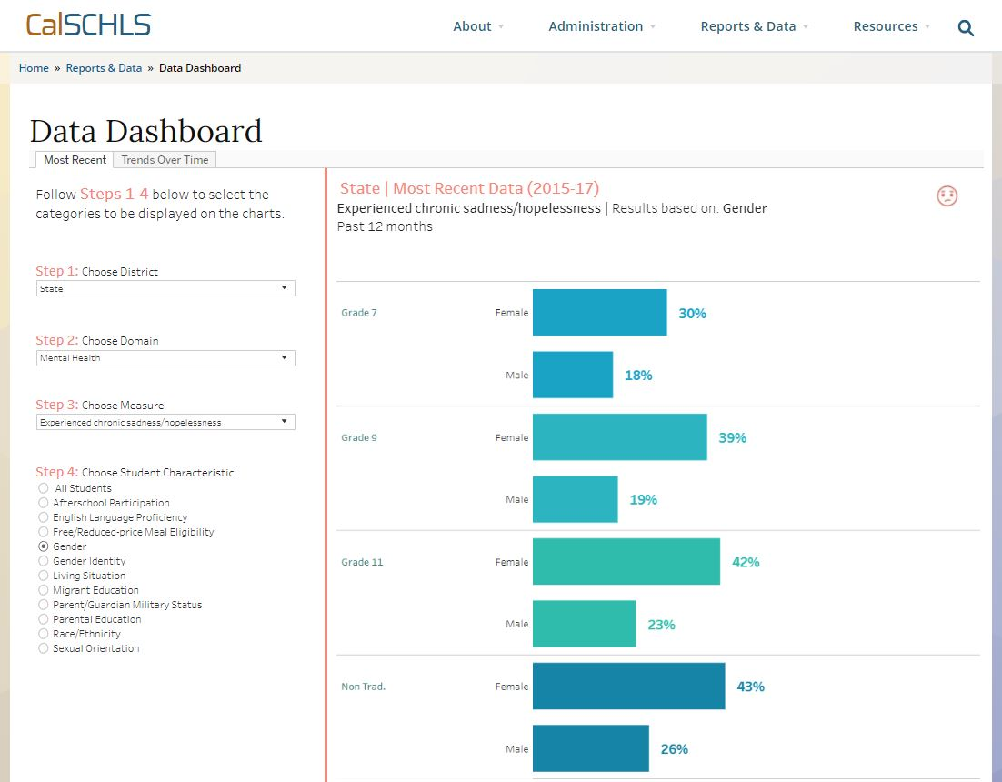
Notes:
Here’s a screenshot showing use of the Dashboard to examine State CHKS chronic sadness results by grade and gender. You can see the list of all the demographic variables that can be analyzed.

Slide 39
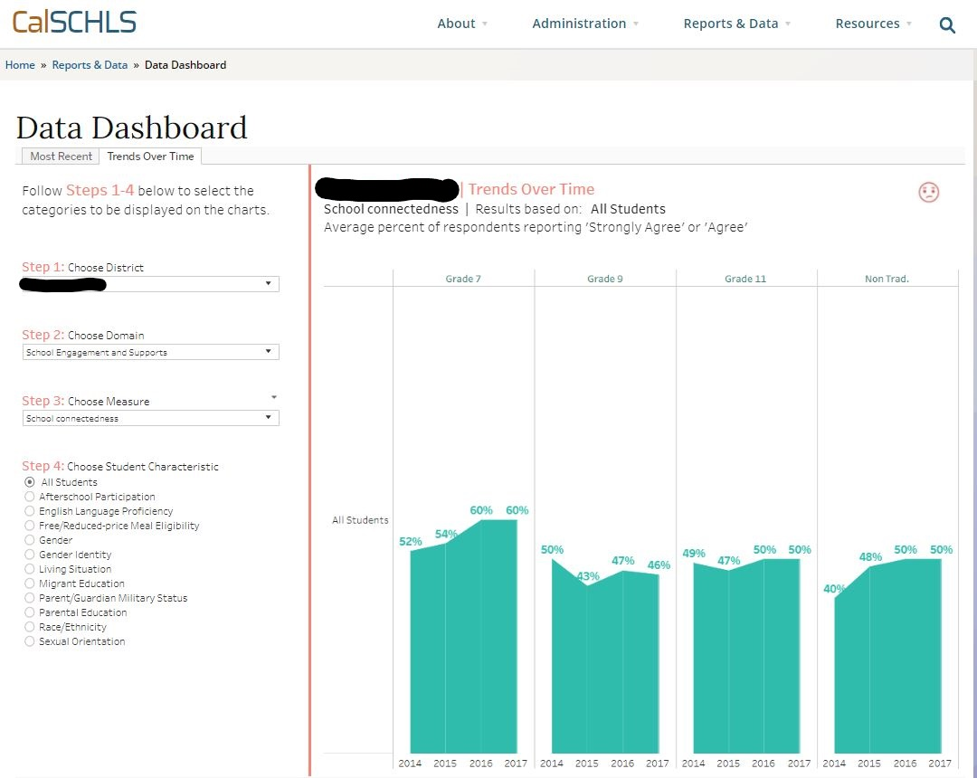
Notes:
This shows a trend line for an anonymous district for school connectedness

Slide 40
Q & A

