Slide 1
California School Climate, Health and Learning Survey System Survey Administration Email your regional center for more information: cal-schls@wested.org for Northern Coastal & Southern California squinn@duerrevaluation.com for North Central California
Visit Our Websites
chks.wested.org
cal-schls.wested.org
californias3.wested.org

Slide 2
Today’s Topics
Cal-SCHLS
What is it?
What does it measure?
For LCAP?
For ESSA?
Administration
Preparation
Registration
Data Collection
Reports
Resources

Slide 3
Cal-SCHLS: What is it?
The largest, most comprehensive system of three interrelated surveys developed for and supported by the California Department of Education:
The CA Healthy Kids Survey (CHKS) for elementary & secondary students (chks.wested.org)
The CA School Staff Survey (CSSS) (cscs.wested.org)
The CA School Parent Survey (CSPS) (csps.wested.org)
Notes:
These surveys provide schools and districts with critical information about the learning and teaching environment, the health and well-being of students, and supports for parents, school staff, and students that foster learning and school success. When used together, data from these three surveys help assess the needs, concerns, and successes of the whole school community – teachers, students, and parents – and allow schools and districts to compare perceptions about the status of these areas across stakeholder groups.

Slide 4
Cal-SCHLS: What does it measure? Part 1
CHKS Core Supports Engagement
Safety
CHKS Core Violence Victimization
Substance Use
High Expectations and Caring Relationships
School Climate Index (SCI)
Violence Perpetration
Opportunities for Meaningful Participation
Single score
from 100 to 500
average of 300
Violence Victimization
Perceived School Safety
Harassment and Bullying
School Connectedness
Substance Use at School
Developed for the California Safe and Supportive Schools Project, see www.californiaS3.wested.org
Notes:
There are over 120 questions on the CHKS that ask students about a variety of behaviors, attitudes, and perceptions. It’s difficult to make decisions based on 120 questions, but we can use all of the valuable information that we get from these questions to identify underlying dimensions of school climate. Several analyses have been conducted over the years to identify dimensions—or factors—around which the survey items cohere. There are two general dimensions that emerged: “student supports and engagement,’” on the one hand and “violence, victimization, and substance use,” on the other. These are the two major dimensions of school climate.
These two major dimensions can be further broken down into sub-dimensions to give an even more nuanced understanding of the important components of school climate. Under supports and engagement, there are four sub-dimensions:
High expectations and caring relationships, which refers to the degree that students feel that adults in the school care about them and believe that they can be a success;
Opportunities for meaningful participation, or the availability of activities for students to express voice and make a difference at their school;
Perceived school safety; and
School connectedness, or how much students feel a part of a larger, positive school community.
Under violence, victimization, and substance use, there are also four sub-dimensions:
Violence perpetration, or the frequency of delinquent behavior like fighting or vandalism at school;
Violence victimization, or the frequency of being teased or assaulted at school;
Harassment or bullying, generally and based on different forms of identity; and
Substance use on school property.
Each student who completes the survey gets a single score on each of these eight sub-dimensions. In a school, all the student scores are averaged together to create a single school score for each to eight sub-dimensions. These are then averaged to create single school scores for the two supports and engagement and violence, victimization, and substance use dimensions. And finally, these two are averaged and combined with a school’s truancy rate to create a single school score for overall school climate, which we refer to as the “School Climate Index” or SCI. The SCI was developed for the California Department of Education’s Safe and Supportive Schools program and included on a School Climate Report Card that schools that participate in the program receive annually to help them monitor climate. The SCI is normed on data from all California schools. It ranges from 100 to 500, and an average school has a SCI of 300.

Slide 5
Cal-SCHLS: What does it measure? Part 2
Student social-emotional health and competence.
Student depression/suicide risk, and other mental and physical health risks.
Academic mindset, expectations, and rigor (student, staff).
Student peer relationships (student, staff).

Slide 6
Cal-SCHLS: What does it measure? Part 3
Respect for diversity and equity (student, staff, parent).
Physical environment and resources (student, staff, parent).
Discipline and order; clarity of rules and expectations (student, staff, parent).
School supports (staff, parent).
Staff engagement; parental involvement in school.

Slide 7
Cal-SCHLS: What does it measure? LCAP
Data are provided for four of eight state priorities:
school climate
pupil engagement
parent involvement
facilities
Notes:
The single most valuable tool for developing, goal setting, monitoring, and improving LCAPs.
Provides data to meet the majority of specific LCAP state-priority requirements and also to fulfill the overarching goals and spirit of the legislation.
Data essential to 4 of 8 specific state priorities:
School Climate
Assess student, staff, and parent perceptions of school connectedness and perceived safety
Pupil Engagement
Parent Involvement
Improving Academic achievement—overarching outcome

Slide 9
Cal-SCHLS: What does it measure? LCAP: Numerical, High Need Subgroups
Results can be disaggregated for
ethnicity/race,
English learners,
eligibility for free/reduced price meals,
foster care youth, and
district selected items, e.g., smoker vs. non-smoker; male vs. female, etc.
Notes:
Requires academic improvement for numerically significant (N=30) pupil subgroups and high need students (Ed Code 52052) — and demonstration of actions/services (expenditures) provided to subgroups, English learners, low-income pupils, foster youth to achieve goals.
Cal-SCHLS data can be analyzed to identify and understand needs of the subgroups to improve targeted interventions:
Includes questions to identify survey results by race/ethnicity, gender, foster youth, SES (using parental education question as surrogate), military-connected etc.
Add questions to identify youth in any subgroups of interest/need.

Slide 10
Cal-SCHLS: What does it measure? ESSA
ESSA calls for an annual state report card that includes:
Academic achievement, graduation rates at the high school level, English proficiency, and at least one other valid, reliable, comparable, and statewide non-academic indicator of school quality or student success
Measures of school quality, climate, and safety, including incidences of violence, including bullying and harassment.
Meaningful differentiation of school performance
Disaggregation by subgroups
Notes:
2016-2017 is a transitional year, but ESSA has implications for LCAP and Cal-SCHLS.
Multiple-Indicator Statewide Accountability System
Each state must establish a statewide school-quality accountability system based on multiple indicators, including: (1) academic achievement, (2) another academic indicator - which must include graduation rates at the high school level, (3) English proficiency, and (4) at least one other valid, reliable, comparable, and statewide non-academic indicator of school quality or student success on which schools can be meaningfully differentiated in school performance
Annual Meaningful Differentiation of Schools
All indicators must enable meaningful differentiation on all indicators in all public schools on an annual basis.
Subgroup Disaggregation
These indicators must be disaggregated, monitored, and reported by states for subgroups of students, including: major racial and ethnic groups, socioeconomically disadvantaged, disabilities, English learners, gender, migrants, homeless, foster care, and military connected
An annual state report card must be disseminated widely to the public that includes how each school, including on measures of school quality, climate, and safety, including rates of in-school suspensions, out-of-school suspensions, expulsions, school-related arrests, referrals to law enforcement, chronic absenteeism (including both excused and
unexcused absences), incidences of violence, including bullying and harassment.

Slide 11
Cal-SCHLS: What does it measure? LCFF and ESSA
Notes:
On May 26 and June 1, 2016, the CDE, with support from the Comprehensive Center at WestEd, hosted an informational webinar to provide an overview of the ESSA and an update on the development of the ESSA State Plan. 2016-2017 is a transitional year, but ESSA has implications for LCAP and Cal-SCHLS.
http://www.cde.ca.gov/re/es/presentations.asp

Slide 12
Cal-SCHLS Administration http://chks.wested.org/administer/

Slide 13
Cal-SCHLS Administration Preparation Part 1
http://chks.wested.org/administer/
Download and review this PowerPoint.
Download and read Guidebook for the Cal-SCHLS.
Download and review surveys and modules.
Download the Parent Consents and introductory letters.
Download the Fee Schedule.

Slide 15
Cal-SCHLS Administration Preparation Part 2
Obtain superintendent/school board approval.
Form an advisory committee.
Determine which surveys and modules are needed to meet data goals and needs.
Select a method of administration. Online administrations are strongly encouraged.
Notes:
In most districts, the surveys will require authorization from the district superintendent and/or the school board. Even if this is not required, keep them informed about the surveys and obtain their support.
An advisory committee of influential school and community leaders can be a tremendous advantage in planning and conducting the surveys, and in determining how to address the needs that are identified. It may be especially valuable in addressing local concerns that need to be taken into consideration.
All three surveys are designed to be responsive to local needs and standards. Work with your advisory committee and superintendent to identify the main survey objectives and potential data uses, as well as local concerns and issues that need to be taken into consideration
The student and parent survey are available for online and paper administration. The staff survey is administered online only.

Slide 16
NEW Social and Emotional Health Module
?
35
NEW Social and Emotional Health Module
?
46
Notes:
Newly revised Social and Emotional Module is available now, but we don’t have the stats on it yet. The number of questions gives you an idea of how long the survey takes to complete on line.

Slide 17
Cal-SCHLS Administration Preparation Part 3
Request Memorandum of Understanding (MOU). Email your regional center:
cal-schls@wested.org for Northern Coastal and Southern California
squinn@duerrevaluation.com for North Central California
Choose a consent option: Passive or Active for secondary; Active for elementary.
Distribute parental consent forms and introductory letters (samples found at http://chks.wested.org/administer/instructions/parent-consent/).
Make survey instrument available to parents in the district office or on the school’s website.
Notes:
Districts that administer any one of the Cal-SCHLS are required to sign a Memorandum of Understanding. (MOU). The MOU outlines the responsibilities of both the district staff and the Technical Advisors and the conditions that must be met in administering the survey.
Passive Parent Consent. Written notice is sent to parents/guardians about the survey, who in turn notify the school ONLY if they do not want their child to participate in the survey. The challenge with passive parent consent is ensuring that parents are fully notified.
Active Parent Consent. No child can be surveyed until a parent/guardian has provided written permission. If a Parent Consent Form is not returned, it must be assumed that parental permission has not been granted. The challenge with active parent consent is making sure that parents receive and return the forms to the school.
The district MUST adopt a formal consent policy. This is regardless of the type of consent you are using. Model board policies are available from the COE.
Parent consent forms are on the website, also available is an introductory letter for your use. They are translated and modifiable.
Carefully monitor consent form returns (active consent) and refusals (passive consent).
Make the survey available in the school and district office.
Parent consent forms in 25 languages are available on our website as well as the introductory letter to parents about the student survey. Typically the introductory letter and consent forms are given to students to take home to their parents. You could also send the CSPS home at the same time.
Distribute letters to parents
Introductory Letters are available at Cal-SCHLS website (cal-schls.wested.org). These letters can be sent out along with the Parental Consent Forms to help parents/guardians fully understand the surveys purpose and value.
You’ll need to distribute the Parent Consent Forms, implement strategies to increase participation, and motivate your school staff.
Although the details surrounding Parent Consent Form distribution varies for passive versus active parent consent, the basic issues are the same. You’ll need to distribute the Parent Consent Forms, implement strategies to increase participation, and motivate your school staff.
Monitor parent consent form returns
A critical step in the parent consent process is monitoring the return of the forms. The method you choose for monitoring returns may vary depending on a school’s structure and the method of parent consent you use.
Carefully track the distribution and return of forms so you can identify students whose parents never returned the Parent Consent Form or declined participation.
If one week before the survey the targeted parent return rates are not being reached in any classroom or school, contact your Technical Advisor immediately.

Slide 18
Cal-SCHLS Administration Registration
Sign and return MOU to your regional center.
Receive registration form and directions.
The registration form is an excel document made up of three tabs.
Follow the directions to complete the registration form and return it to your regional center.

Slide 19
Notes:
Core Module is require for 7th and 9th grade in order to receive the CDE subsidized price of 30 cents per enrollment number:
Demographics, including LCAP-required subgroups
School climate, connectedness, and learning engagement
School developmental supports (relationships, expectations, participation)
School violence, victimization, and safety
Mental health (chronic sadness, suicide ideation)
ATOD use, attitudes, and perceived norms

Slide 20
Notes:
Core Module is require for 7th and 9th grade in order to receive the CDE subsidized price of 30 cents per enrollment number:
Demographics, including LCAP-required subgroups
School climate, connectedness, and learning engagement
School developmental supports (relationships, expectations, participation)
School violence, victimization, and safety
Mental health (chronic sadness, suicide ideation)
ATOD use, attitudes, and perceived norms
No Cost Supplemental Modules
School Climate
Drug Free Communities (DFC)
Alcohol and Other Drugs (AOD)
Tobacco
Building Healthy Communities (BHC)
Cal-Well (student mental health)
$100 Supplemental Modules:
Safety and Violence
District After School Program
Resilience & Youth Development
Social Emotional Health
Sexual Behavior
Gang Risk Awareness
Military Connected School
Physical Health & Nutrition
Closing the Achievement Gap
Gender & Sex-Based Harassment Module
Districts can pick one of the two modules when administering the paper survey, due to constraints of the scantron. Can administer both online.
Determine survey configuration
Review supplementary modules covering specific topics and decide if the data from any module(s) would be useful to the district.
In consultation with Cal-SCHLS Regional staff, districts can add custom questions to address other topics of local interest.
Take into consideration the number of questions students are being asked to answer and discuss the survey configuration with Cal-SCHLS Regional Staff.
Once the survey configuration has been finalized the online version will be prepared for use and the paper version will be sent to the district coordinator.

Slide 21
Cal-SCHLS Administration Instructions for the Registration Tab
Indicate supplemental modules to be administered. Each supplemental module carries a $100 set up fee (i.e., 3 supplemental modules = $300)
To use custom questions, please attach a copy of the questions when your return the registration form. Custom questions carry a fee of $200 per every 3 questions or fraction thereof.
Elementary surveys may include 1 additional module.
Secondary surveys may include up to 4 modules, but each additional module increases the amount of time needed to administer the survey.
Indicate the order in which you would like your supplementary modules to appear. If you are administering the survey on Scantrons, we will send you a master copy of your survey in this order.

Slide 22
Notes:
All teachers, administrators, and other certificated staff including paraprofessionals and aides, regardless of grade;
All personnel working in the areas of counseling, health, prevention, and safety.
All classified staff.
Staff working at multiple sites should be counted in the target sample at all sites.
They should not fill out a survey if they don’t think they work at that site enough to answer the questions.
Off-site staff such as bus drivers and district personnel not tied to, or having knowledge of, a specific school site, should not take the survey.
If you have questions about whether to include certain staff in your survey, contact your Technical Advisors.
Learning supports section for staff with health, prevention, safety or counseling responsibilities
School services, resources, and policies related to student behavior, health, and overall climate.
Discipline enforcement
Extent of youth development, health, AOD, character education, violence, and harassment programs
Resources for safety and prevention; prevention priorities and professional development
School-community collaboration

Slide 23
Cal-SCHLS Administration Instructions for the Enrollment Tab
List each school taking the survey and indicate whether the student survey is being administered online or on paper for each school.
Provide enrollment for each grade/school taking the surveys.
For paper administrations only: List the number of classes of the surveyed grades at each school. This information will be used to determine materials needed.
List all non-traditional, continuation, or community day students in grades 7-12 in the NT column.
Alternative School of Choice enrollments should be listed by individual grade (not NT)
NEW 2016-2017: Order reports and data at the time of registration.

Slide 24
Notes:
Should be given to all parents in the school.
Completely anonymous.
Attractively short in length (58 questions).
Translated into 26 languages (only English and Spanish available on-line).
Biggest challenge obtaining high level of parent participation.
Available for print, online, administration Providing multiple options fosters higher participation.
CSPS content is integrated with most of the topics covered in the CHKS and CSSS, allowing a comparison of factors from the perspective of students, staff, and parents.
The survey is attractively short in length while still addressing core school quality factors.
The CSPS is completely anonymous; individual parent responses can never be traced back to respondents.
The survey addresses equity, bias, and cultural responsiveness, and a special report displaying these findings by racial/ethnic groups can be ordered at no additional cost. The survey has been translated into 26 languages (only English and Spanish available on-line).
The survey can be conducted online, on paper, or using a combination of the two strategies.
The CSPS is a companion tool to the California Healthy Kids and School Climate surveys.
Using all 3 surveys will give you a full picture of the school’s school climate
Provides teachers, administrators, and other school staff with information directly from parents regarding:
Parent involvement
Student achievement
Health and well-being
The act of asking parents to participate and communicate their perceptions of the school is in itself an empowering parent-involvement activity.
An invaluable LCAP tool for meeting state priority for parent involvement.

Slide 25
Cal-SCHLS Administration Instructions for the Paper Parent Survey Tab
The online parent survey is available in English and Spanish.
The paper parent survey is available in 24 languages.
A mixture of online and paper may be used at each school.
The paper survey is answered on the questionnaire itself, so all English and Spanish copies must come from us. Other languages may be reproduced on site if needed.
List the number of paper copies of the parent survey you need in each language on the registration form. Please note paper copies of the parent survey have additional fees.

Slide 26
Cal-SCHLS Administration Data Collection Part 1
Select survey dates.
Obtain support of principals--encourage their participation and garner their enthusiastic support.
Train school coordinators and teachers.
Provide teacher proctoring instructions;
Prepare to answer student concerns; and
Monitor and confirm consents.
Notes:
Meet with all the principals personally to answer their questions and obtain their support. Emphasize how important it is that they strongly communicate the value of the survey(s) and their expectations that teachers will fully support it and comply with all procedures. Emphasize how easy and quick the surveys are –especially online.
Establish a general time period in which you will administer the surveys. Then work with the School Coordinators to set up specific, convenient dates for each school.
Participation by students, staff, and parents is voluntary. However, it is important to encourage a high survey response rate to avoid a biased sample. The first step is to engender a thorough understanding of the value of the survey
On the Cal-SCHLS website are instructions for coordinators, teachers, and proctors. Proctors are the individuals that administer the survey in the classroom. In most cases the proctor is the teacher.
It is very important that all people involved in the survey—School Coordinators, teachers, and proctors—thoroughly understand its importance and the tasks for which they are responsible. The best way to assure this is through training.
Your goal should be to not only inform them but to garner their enthusiastic support.
As part of the Teacher and Proctor instructions from the website is a Assurance of Confidentiality form. Whomever is administering the survey in the classroom to students should read and sign this document. It makes the proctor, whether the teacher or another adult, aware of confidentiality issues.
All staff involved in administering the survey must sign the Assurance of Confidentiality. This communicates that the commitment to confidentiality is a serious one and reinforces the survey administrator’s obligation to protect student privacy. These assurances can be made available for parents to view along with the survey instrument.
Prepare to answer students’ concerns - Make arrangements at the district or school level for someone, such as a counselor or health/prevention specialist, to be available to students who have questions or concerns as a result of their participation in the survey. Be sure your staff know who this person is, and know where to send the students.
Confirm consent — Near the day of the CHKS administration confirm which students will be participating in the administration. When using passive consent the parent sends back the “opt out” form if they do not want their child to participate in the survey. There is a form in the Teacher and Proctor instructions that can be used to monitor which students return an opt-out form.
Monitor parent consent form returns
A critical step in the parent consent process is monitoring the return of the forms. The method you choose for monitoring returns may vary depending on a school’s structure and the method of parent consent you use.
Carefully track the distribution and return of forms so you can identify students whose parents never returned the Parent Consent Form or declined participation.
If one week before the survey the targeted parent return rates are not being reached in any classroom or school, contact your Technical Advisor immediately.
Administer the survey — Coordinate with school coordinators regarding which students have consent, the times and dates of administration at their site, and review administration procedures.

Slide 27
Cal-SCHLS Administration Data Collection Part 2
Survey Instruments, Materials and Logins
Receive complete survey instrument from your regional center.
Photo copy survey instrument for each school office and/or upload to website.
For paper administrations, make enough photo copies for all schools/students.
For paper administrations: Receive scantrons and transmittal envelopes via ground shipping.
For online administrations: Receive logins and passwords via email.

Slide 28
Cal-SCHLS Administration Data Collection Part 3
Collect signed confidentiality assurances.
Distribute materials:
Survey instruments, scantrons, envelopes for student paper administrations, student logins and passwords for online administration;
Staff logins and passwords; and
Parent paper surveys and/or logins and passwords.
Administer the survey.
Notes:
Collect signed confidentiality assurances — As part of the Teacher and Proctor instructions from the website is a Confidentiality Assurance form. Whomever is administering the survey in the classroom to students needs to read and sign this document. It makes the proctor, whether the teacher or another adult, aware of confidentiality issues. For instance, during a test a teacher would walk about the classroom. During the survey it is recommended that the teacher or proctor not walk around the room. This will make the students more likely to answer the questions honestly. All staff involved in administering the survey must sign the Assurance of Confidentiality. This communicates that the commitment to confidentiality is a serious one and reinforces the survey administrator’s obligation to protect student privacy. These assurances can be made available for parents to view along with the survey instrument.
Administer the survey — Coordinate with school coordinators regarding which students have consent, the times and dates of administration at their site, and review administration procedures.

Slide 36
Cal-SCHLS Administration CSSS Data Collection
Fill out Survey Instructions for Staff for each participating school.
Copy the Instructions and distribute one to each staff member at each site; e.g., email, put them in staff mailboxes or distribute at staff meetings.
Encourage high participation rate
Have principal communicate the importance of staff taking the survey.
Provide release time for the survey.
Offer incentives.
Conduct a raffle: Ask each staff person to print out the last page of the online survey as proof of participation.
District Coordinators monitor participation online in “real time” and send reminders to staff and parents.
Notes:
Survey administration materials will be sent to the District Coordinator via email. This will include a master letter (Survey Instructions for Staff) for each participating school containing the school name, a school-specific login and password, and instructions on how to fill out the survey online.
Copy the letters and distribute one to each staff member at each site; e.g., put them in staff mailboxes or distribute at staff meetings. Staff should follow the instructions and fill out the survey online, from any computer.
Fill out Survey Instructions for Staff for each participating school.
Fill in with the Coordinator’s contact information and the date the survey window should open.
Copy the Instructions and distribute one to each staff member at each site; e.g., email,put them in staff mailboxes or distribute at staff meetings.
Encourage high participation rate to ensure valid, representative survey results.
Have principal communicate the importance of staff taking the survey.
Staff should follow the instructions and fill out the survey online, from any computer.
You may also ask each staff person to print out the last page of the online survey, where he/she logs out of the system, and return it to you as proof of participation. (This page does not contain any answers or identifying information.)
Having staff appoint a trusted colleague to collect this information may be a workable solution.

Slide 37
Cal-SCHLS Administration CSPS Data Collection
Use both paper and online for parents:
Direct mailings with postage paid return envelopes.
Parent volunteer hands out surveys during school drop-off and pick- up.
Provide survey at school sponsored events (sports, PTA meetings, parent meetings).
Send home with the student along with the parent consent form.
Encourage high participation rate
Have principal communicate the importance of staff taking the survey.
Offer incentives for completed surveys (free admission to school events; i.e., football games, theater productions).
Conduct a raffle:
District Coordinators monitor participation online in “real time” and send reminders to staff and parents.
Notes:
Parent Survey
The materials will include school-specific login and passwords which will need to be distributed to School Coordinators.
Make sure all parents get the website address.
Districts must request and receive parent surveys from the Cal-SCHLS Regional Center. The parent survey cannot be copied.
Administration of the paper survey is more challenging, because forms must get out to the parents, as well as back to the school or district.
Provide return envelopes so the surveys can be returned anonymously

Slide 38
Cal-SCHLS Reports
District Reports
School Reports
Disaggregated Reports
ethnicity/race,
English learners,
eligibility for free/reduced price meals,
foster care youth, and
district selected items, e.g., smoker vs. non-smoker.
School Climate Report Cards

Slide 39
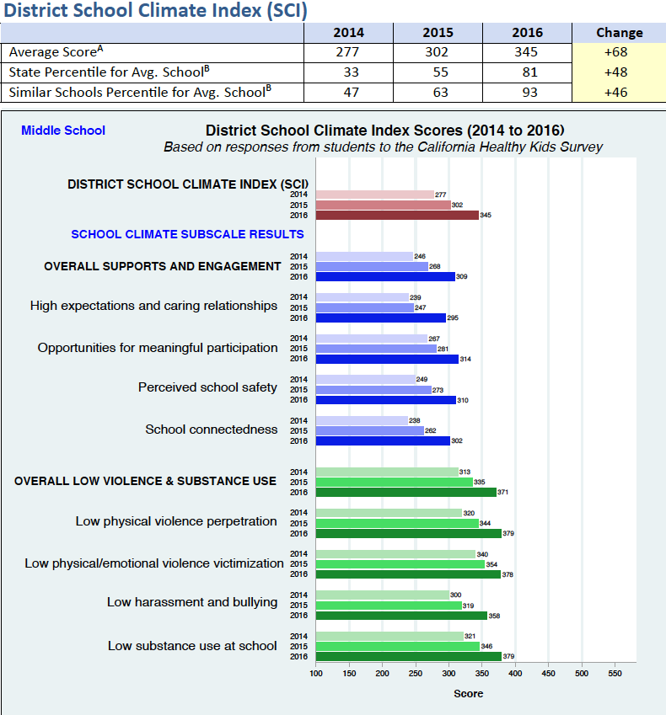
Notes:
CalSCHLS users can also request a user-friendly School Climate Report Card, with a summary index, to help guide LCAP work. Here’s sample from the School Climate Report Card for Secondary Schools developed for the California Dept. of Education’s Safe and Supportive School—S3—program based on the data from the CHKS Core Module. Middle and high schools that request their own report card as a custom service ($100 fee). It includes a single score School Climate Index, the percentile that their SCI ranks in the state, and a graph depicting their state percentile for the SCI and the school climate dimensions and sub-dimensions that we just described. School can use the report card to assess needs, monitor changes from year to year, and evaluate the impact of interventions.
The summary School Climate Index (SCI) helps schools gain an overview to and monitor their improvement efforts in regard to overall climate and eight crucial domains, summarizing 120 items. It measures the degree to which students are supported — that they experience caring adult relationships are held to high expectations, and engage in meaningful participation — that they feel connected to and safe at school, that they experience low levels of harassment and victimization, and that students do not engage in violence and substance use at school. Thus the report card is useful for both monitoring climate and safety, but also engagement.
Each student who completes the survey gets a single score on each of these eight sub-dimensions. In a school, all the student scores are averaged together to create a single school score for each to eight sub-dimensions. These are then averaged to create single school scores for the two supports and engagement and violence, victimization, and substance use dimensions. And finally, these two are averaged and combined to produce the SCI. The SCI is normed on data from all California schools. It ranges from 100 to 500, and an average school has a SCI of 300.

Slide 40
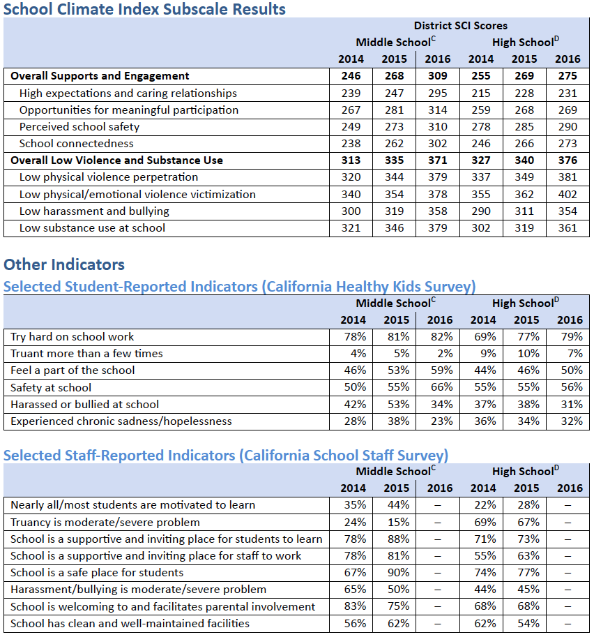

Slide 41
Cal-SCHLS Resources Workshops and Trainings
Administration Workshop (2-3 hours on site)
Preparation, Registration, Administration
Reports
Data Workshop (2-5 hours on site)
Interpret Data
Set Goals
Plan Next Steps
Student Listening Circle (4-5 hours on site)
Orientation and description of the process (adults only)
Orientation and student practice (students only)
The listening circle (students and adults)
Dialogue between students and adults
Action Items and Next Steps
Combination Data Workshop and Student Listening Circle (7-8 hours on site)
Notes:
All workshops carry the CDE supported fee of $125 per hour (preparation, travel, and presentation time), plus travel expenses.

Slide 42
Cal-SCHLS Resources cal-schls.wested.org californias3.wested.org
Making Sense of School Climate: Using Cal-SCHLS to Inform School Improvement Efforts
Making Data-driven Decisions in Student Support and School Mental Health Programs: A Guidebook for Practice
Helpful Resources for Local Control and Accountability Plans and School Safety Plans: Cal-SCHLS.
Assessing School Climate: Cal-SCHLS
Assessing Social Emotional Health and Learning: Cal-SCHLS

Slide 43
Questions? Comments?
Email your regional center: cal-schls@wested.org for Northern Coastal & Southern California squinn@duerrevaluation.com for North Central California
Visit Our Websites
chks.wested.org
cal-schls.wested.org
californias3.wested.org

